Slide 1
Employee Data Analysis using Excel
STUDENT NAME: S Krishnapriya
REGISTER NO: 312208958
DEPARTMENT: B Com General
COLLEGE: Chevalier T Thomas Elizabeth college for women’s

Slide 2
PROJECT TITLE
Employee Performance Analysis using Excel

Slide 3


AGENDA
Problem Statement
Project Overview
End Users
Our Solution and Proposition
Dataset Description
Modelling Approach
Results and Discussion
Conclusion
3/21/2024 Annual Review

Slide 4

PROBLEM STATEMENT
The goal is to analyze employee data to gain insights into workforce dynamics, performance, and employee satisfaction. The analysis should help identify patterns, trends, and areas for improvement in employee management practices.

Slide 5

PROJECT OVERVIEW
. To analyze and interpret employee data to enhance workforce management, optimize performance, and improve employee satisfaction and retention Background. Organizations collect a wealth of data on their employees, including demographics, performance metrics, compensation, and feedback. Proper analysis of this data can provide valuable insights into workforce trends, strengths, and areas needing improvement. The findings will support strategic decision-making to drive organizational success

Slide 6

WHO ARE THE END USERS?
The end user in employee performance analysis include:
1. Human resources management professional
2. Data analyst
3.Team leader

Slide 7

OUR SOLUTION AND ITS VALUE PROPOSITION
*Filter- purpose to fill the missing value
*Conditional formatting -blank values
*Using pivot table and chart

Slide 8
Dataset Description
*Employee data set - kaggle
*There are 26 feature
*The important ten features are
1.Employee id
2.First name
3.Last name
4.Gender
5.Employee status
6.Employee type
7.Employee classification
8.Perfomance score
9.Current employee rating
10.Business unit

Slide 9

THE "WOW" IN OUR SOLUTION
Performance Level - These includes the categories such as level in very high medium , low etc.
3/21/2024 Annual Review
9

Slide 10
MODELLING
The modelling in this employee performance analysis project includes the following
*Data collection
*Data cleaning
*Pivot table
*Chart
10

Slide 11
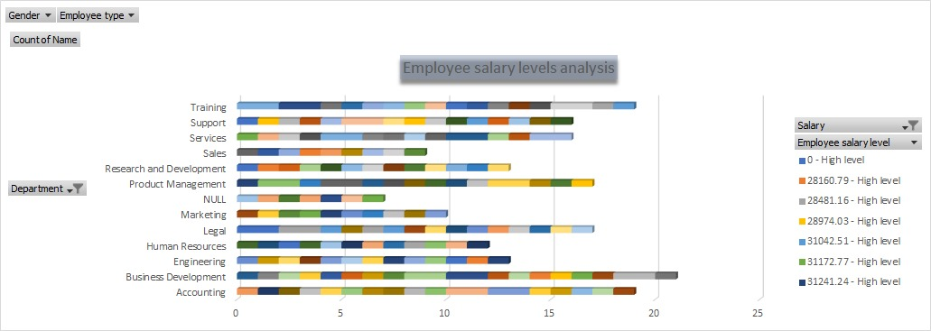
RESULTS
11

Slide 12
conclusion
The conclusion is the employee data analysis reveals is the key insights in workforce performance and areas needed for improvement the effective data analysis provide a foundation for the improvised planning and operational development , which leads to a motivational and productive workforce environment

